Slide 1
EoS Models for PVT – use of approach from PTA
Material donated to Energistics by Schlumberger and Kappa Engineering
19 June 2015

Slide 2
Analysis Models - 1
The analysis models are divided into 4 model Sections.
Wellbore concerns the wellbore storage modelling
Near Wellbore (the “skin factor” effects of damage, convergence etc. modelling)
Reservoir (the reservoir modelling, such as homogeneous, dual porosity, etc.)
Boundary (the modelling of boundaries such as faults, closed volumes, etc.)
There is 1 Wellbore Model Section, and 1 to many Layer Models per Test Location Analysis.
Each Layer Model groups Near Wellbore, Reservoir and Boundary Sections.
Note: A PTA or RTA “model” may be one mathematical algorithm dealing with all Sections in one calculation but for transfer purposes it is always broken into these logical Sections

Slide 3
Analysis Models - 2
The commonly-used models are built into the schema.
Models are represented by a set of Parameters
Abstract Base Models for each Section type contain the Parameters which recur for all Models within that Section
Inheritance is used to restrict each Model to appearing in the Section type to which it belongs
Example: Reservoir Base Model is abstract and contains all the common reservoir Parameters, e.g. permeability. Dual porosity model adds the λ and ώ Parameters.
Some of the Parameters are optional. The multiplicity of each Parameter within a Model Section is used to control this.

Slide 4
Parameters
All the Parameters have a fixed type and also a fixed Abbreviation, e.g. “HorizontalRadialPermeability” and “K”.
Parameters have their value in a specific element for that Parameter, e.g. “permeability”. These elements are typed with the appropriate Energistics quantity class, e.g. “permeabilityMeasure” which is then restricted to appropriate Units of Measure, e.g. “Millidarcies”.
Parameters have a UID
Parameters have an optional Source Result Ref. If in an Analysis a parameter is an input (ie fixed) rather than an output then this Ref can be used to point to the UID of the source Parameter (in a different Test Location Analysis)for the value

Slide 5
Custom Models and Parameters
Custom Model Sections can be used to transfer model data which is not one of the built-in models.
Each Model Section type has a Custom Model, e.g. “CustomBoundaryModel”. These Custom Models inherit the Base Model for that Section type. They add a Model Name.
Custom Models can add Any Parameter elements which allow any of the built-in Parameters to be used.
Custom Models can also add Custom Parameter elements. These are to allow transfer of parameter data where there is not a built-in Parameter.
Custom Parameters have name and abbreviation (uncontrolled), and a General Measure Type of quantity, meaning the Units of Measure are not controlled.
Interoperability using Custom Models is therefore limited.

Slide 6
Model & Parameter Further Details
A Layer Model can have optional Layer To Layer Connections to other Layers. The UID of the other Layer is used to identify it, and an Inter Layer Connectivity Parameter quantifies the connection.
Layer model can be flagged as representing total multiple layers’ combined response.
A small number of Parameters are enums
A small number of Model Sections have sub-models in addition to Parameters. Example: the HorizontalWellboreMultipleVariableFracturedModel requires to describe many different fractures. In this case a sub-model element (SingleFractureSubModel) is used to represent each fracture. These sub-models use Parameters the same way as other Model Sections.

Slide 7
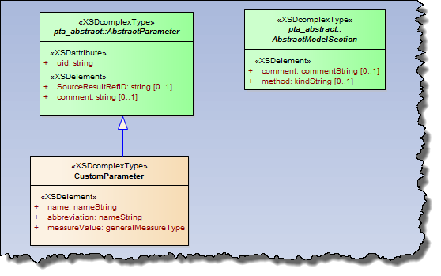
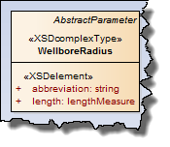
Model Basis - Parameters

Slide 8
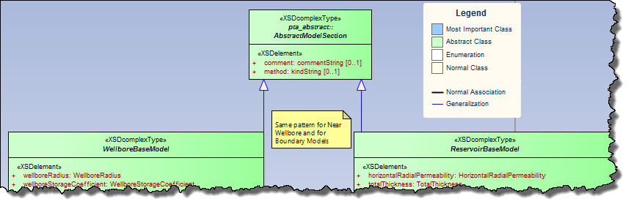
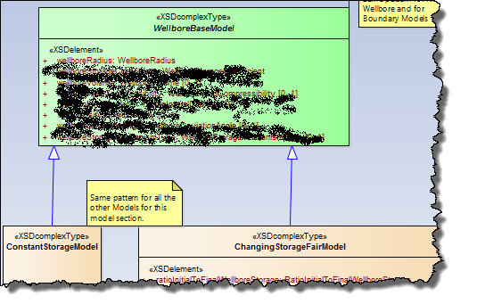
Model Basis - Models

